Slide 1
traffic management system
Optimizing traffic flow and safety

Slide 2
introduction
An Internet of Things(IoT) enabled intelligent traffic management system can solve pertinent issues by leveraging technologies like wireless connectivity and intelligent sensors.
Considered a cornerstone of a smart city ,they help improve the comfort and safety of drivers , passengers and pedestrians.

Slide 3
problem statement
Tailgating ,aggressive driving , speeding and sudden lane changes can also cause accidents and slow down traffic flow.
IoT powered traffic lights have the ability to adjust to traffic conditions in teal time , helping to alleviate congestion and prevent accidents.
IoT sensors can also monitor variations in traffic patterns and provide real-time data to drivers enabling them to choose routes that avoid traffic congestion.

Slide 4
objectives
IoT based street lighting and traffic management system.
Dynamic road traffic management for smart cities.
IoT based solutions for road safety and traffic management in intelligent transportation systems.
A survey on IoT based traffic control and prediction mechanism.

Slide 5
Components of traffic management system
Data collection
Data transmission
Data analysis
Data conversion into intelligent information
Data transmission to end-users

Slide 6
Traffic data collection
Manual traffic counts are conducted by an individual positioned roadside , recording passing vehicles on a form.

Slide 7
Data analysis
Data collection
Data aggregation
Data preprocessing
Traffic pattern identification
Anomaly detection
Data visualization
Machine learning and predictive
Decision support
Feedback loop

Slide 8
Traffic control
For smart traffic control, IoT sensors are installed in vehicles.
These sensors are integrated with traffic signals , street lights etc.
Sensors facilitate continuous monitoring and help reduce accidents.

Slide 9
Intelligent transportation systems (its)
IoT-based ITS (IoT-ITS) makes easy transport services using interconnected mobile devices to ensure real-time data communication and remote access.
It enables real-time data management regarding driver activity, optimized routes, fuel consumption analysis, and other reasons.

Slide 10
benefits
The objectives of STMS are to reduce traffic congestion, improve air quality, enhance road safety, improve data analytics, and enhance emergency response
The benefits of implementing a technology-based traffic management system include improved public transit, cost-effectiveness, real-time data analysis, and others

Slide 11
challenges
Inability to utilize vehicles’ capacity
Inefficient route management
Inability to track consignments
Increased transportation cost
Inability to deliver orders on time

Slide 12
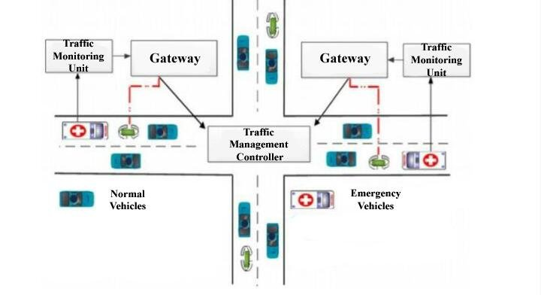
Architecture of traffic management system

Slide 13
THANK YOU!

